Slide 1
What is Big Data
Big Data is a term used for a collection of data sets that are large and complex, which is difficult to store and process using available database management tools or traditional data processing applications. The challenge includes capturing, curating, storing, searching, sharing, transferring, analyzing and visualization of this data.
Data which are very large in size is called Big Data. Normally we work on data of size MB(WordDoc ,Excel) or maximum GB(Movies, Codes) but data in Peta bytes i.e. 10^15 byte size is called Big Data.
It is stated that almost 90% of today's data has been generated in the past 3 years.

Slide 2
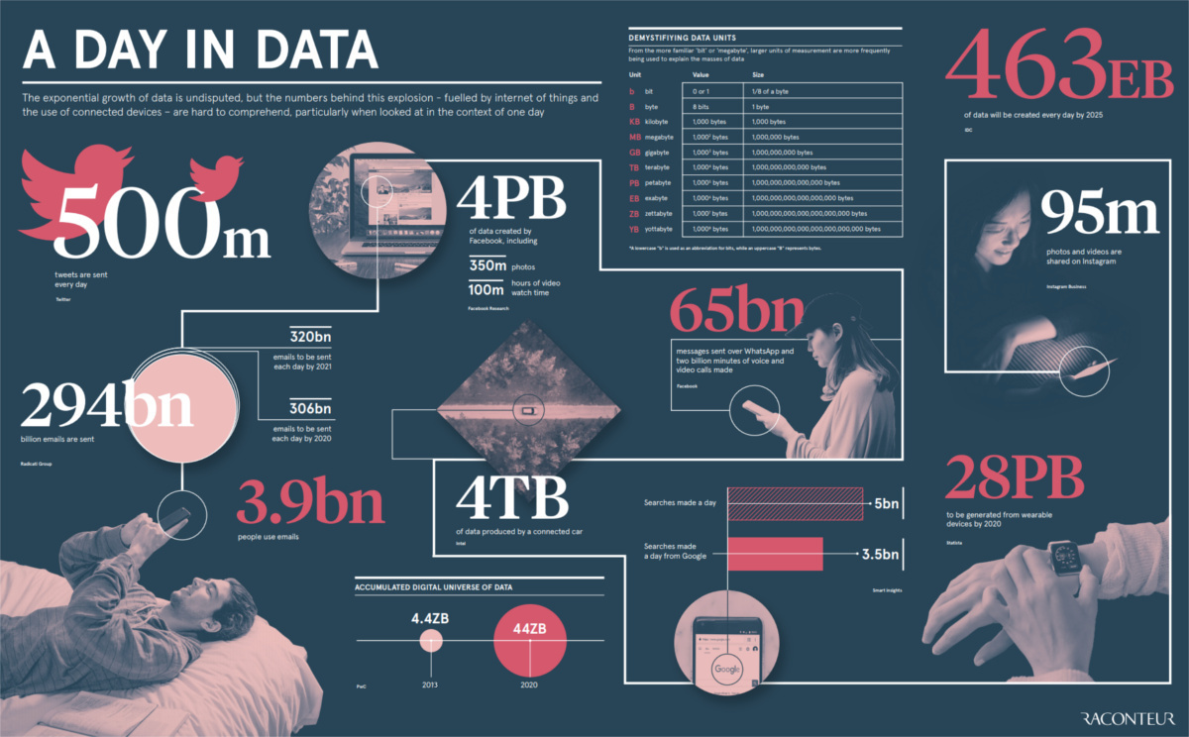

Slide 3
Sources of Big Data
These data come from many sources like
Social networking sites: Facebook, Google, LinkedIn all these sites generates huge amount of data on a day to day basis as they have billions of users worldwide.
E-commerce site: Sites like Amazon, Flipkart, Alibaba generates huge amount of logs from which users buying trends can be traced.
Weather Station: All the weather station and satellite gives very huge data which are stored and manipulated to forecast weather.
Telecom company: Telecom giants like Airtel, Vodafone study the user trends and accordingly publish their plans and for this they store the data of its million users.
Share Market: Stock exchange across the world generates huge amount of data through its daily transaction.

Slide 4
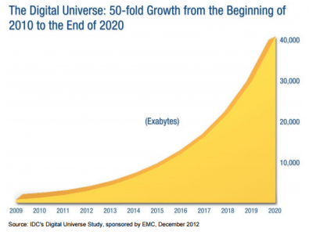
Big Data Characteristics The four characteristics that define Big Data are: Volume, Velocity, Variety, and Veracity.
1. VOLUME
Volume refers to the ‘amount of data’, which is growing day by day at a very fast pace. The size of data generated by humans, machines and their interactions on social media itself is massive. In 2020, 40 Zettabytes (40,000 Exabytes) have generated, which is an increase of 300 times from 2005.

Slide 5

2. VELOCITY
Velocity is defined as the pace at which different sources generate the data every day. This flow of data is massive and continuous. There are 1.03 billion Daily Active Users (Facebook DAU) on Mobile as of now, which is an increase of 22% year-over-year. This shows how fast the number of users are growing on social media and how fast the data is getting generated daily. If you are able to handle the velocity, you will be able to generate insights and take decisions based on real-time data.

Slide 6

3. VARIETY
As there are many sources which are contributing to Big Data, the type of data they are generating is different. It can be structured, semi-structured or unstructured. Hence, there is a variety of data which is getting generated every day. Earlier, we used to get the data from excel and databases, now the data are coming in the form of images, audios, videos, sensor data etc. as shown in image. Hence, this variety of unstructured data creates problems in capturing, storage, mining and analyzing the data.

Slide 7
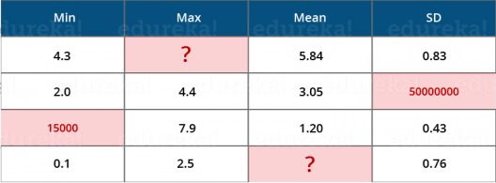
4. VERACITY
Veracity refers to the data in doubt or uncertainty of data available due to data inconsistency and incompleteness. In the table, you can see that few values are missing in the table. Also, a few values are hard to accept, for example – 15000 minimum value in the 3rd row, it is not possible. This inconsistency and incompleteness is Veracity.

Slide 8
Data available can sometimes get messy and maybe difficult to trust. With many forms of big data, quality and accuracy are difficult to control like Twitter posts with hashtags, abbreviations, typos and colloquial speech. The volume is often the reason behind for the lack of quality and accuracy in the data.
Due to uncertainty of data, 1 in 3 business leaders don’t trust the information they use to make decisions.
It was found in a survey that 27% of respondents were unsure of how much of their data was inaccurate.

Slide 9
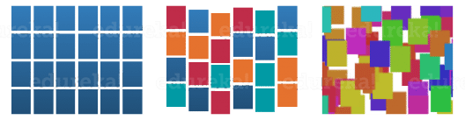
Types of Big Data
Big Data could be of three types:
Structured
Semi-Structured
Unstructured

Slide 10
1. Structured
The data that can be stored and processed in a fixed format is called as Structured Data. Data stored in a relational database management system (RDBMS) is one example of ‘structured’ data. It is easy to process structured data as it has a fixed schema. Structured Query Language (SQL) is often used to manage such kind of Data.
Employee Data (Name, ID, Designation, and Salary) can be stored in a tabular format.

Slide 11
2. Semi-Structured
Semi-Structured Data is a type of data which does not have a formal structure of a data model, i.e. a table definition in a relational DBMS, but nevertheless it has some organizational properties like tags and other markers to separate semantic elements that makes it easier to analyze. XML files or JSON documents are examples of semi-structured data.
Example of semi-structured data is XML files, CSV files, etc.

Slide 12
3. Unstructured
The data which have unknown form and cannot be stored in RDBMS and cannot be analyzed unless it is transformed into a structured format is called as unstructured data. Text Files and multimedia contents like images, audios, videos are example of unstructured data. The unstructured data is growing quicker than others, experts say that 80 percent of the data in an organization are unstructured.
Example of Unstructured Data is e-mail body, Audio, Video, Images, Achieved documents, etc.

Slide 13
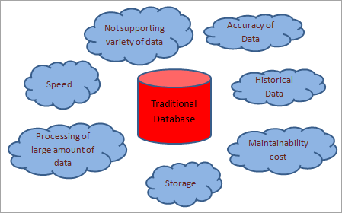
Challenges of Traditional Databases
The Traditional database does not support a variety of data i.e. it is not able to handle Unstructured and Semi-structured data.
A Traditional database is slow while dealing with a large amount of data.
In Traditional databases, processing or analysis of a large amount of data is very difficult.
A Traditional database is capable of storing data that is in terabytes or petabytes.
A Traditional database cannot handle Historical Data and Reports.
After a certain amount of time data clean-up of the database is necessary.
The cost to maintain a large amount of data is very high with a traditional database.
Data accuracy is less in the traditional database as full historical data is not maintained in it.

Slide 14
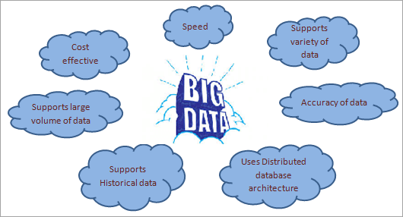
Big Data Benefits Over Traditional Database
Big Data is responsible to handle, manage, and process different types of data like Structured, Semi-structured, and Unstructured.
It is cost-effective in terms of maintaining a large amount of data. It works on a distributed database system.
We can save large amounts of data for a long time using BigData techniques. So it is easy to handle historical data and generate accurate reports.
Data processing speed is very fast and thus social media is using Big Data techniques.
Data Accuracy is a big advantage of Big Data.
It allows users to make efficient decisions for their business based on current and historical data.
Error Handling, Version Control, and customer experience are very effective in BigData.

Slide 15
Challenges and Risks in BigData
Challenges
Data Quality – The problem here is the 4th V i.e. Veracity. The data here is very messy, inconsistent and incomplete. Dirty data cost $600 billion to the companies every year in the United States.
Discovery – Finding insights on Big Data is like finding a needle in a haystack. Analyzing petabytes of data using extremely powerful algorithms to find patterns and insights are very difficult.
Storage – The more data an organization has, the more complex the problems of managing it can become. The question that arises here is “Where to store it?”. We need a storage system which can easily scale up or down on-demand.

Slide 16
Analytics – In the case of Big Data, most of the time we are unaware of the kind of data we are dealing with, so analyzing that data is even more difficult.
Security – Since the data is huge in size, keeping it secure is another challenge. It includes user authentication, restricting access based on a user, recording data access histories, proper use of data encryption etc.
Lack of Talent – There are a lot of Big Data projects in major organizations, but a sophisticated team of developers, data scientists and analysts who also have sufficient amount of domain knowledge is still a challenge.

Slide 17
Risks:
It can handle a variety of data but if companies cannot understand requirements properly and control the source of data then it will provide flawed results. As a result, it will need a lot of time and money to investigate and correct the results.
Data security is another risk with the BigData. With a high volume of data, there are higher chances that someone will steal it. Data hackers may steal and sell important information (including historical data) of the company.
Also, Data Privacy is another risk for BigData. If we want to secure the personal and sensitive data from hackers then it should be protected and must pass all the privacy policies.

Slide 18
Big Data Technologies
Following are the technologies that can be used to manage Big Data:
Apache Hadoop
Microsoft HDInsight
No SQL
Hive
Sqoop
BigData in Excel

Slide 19
Applications of Big Data
Following are the domains where it is used:
Banking
Media and Entertainment
Healthcare Providers
Insurance
Education
Retail
Manufacturing
Government

Slide 20
Smarter Healthcare: Making use of the petabytes of patient’s data, the organization can extract meaningful information and then build applications that can predict the patient’s deteriorating condition in advance.
Telecom: Telecom sectors collects information, analyzes it and provide solutions to different problems. By using Big Data applications, telecom companies have been able to significantly reduce data packet loss, which occurs when networks are overloaded, and thus, providing a seamless connection to their customers.
Retail: Retail has some of the tightest margins, and is one of the greatest beneficiaries of big data. The beauty of using big data in retail is to understand consumer behavior. Amazon’s recommendation engine provides suggestion based on the browsing history of the consumer.

Slide 21
Traffic control: Traffic congestion is a major challenge for many cities globally. Effective use of data and sensors will be key to managing traffic better as cities become increasingly densely populated.
Manufacturing: Analyzing big data in the manufacturing industry can reduce component defects, improve product quality, increase efficiency, and save time and money.
Search Quality: Every time we are extracting information from google, we are simultaneously generating data for it. Google stores this data and uses it to improve its search quality.

Slide 22
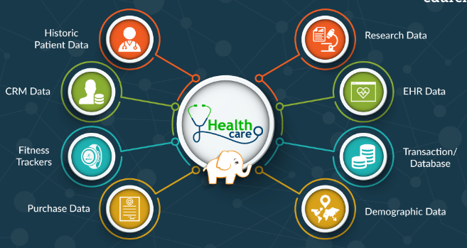
Healthcare

Slide 23
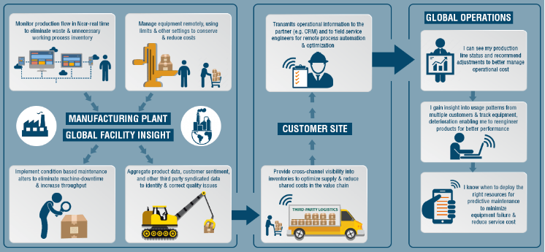
Manufacturing

Slide 24
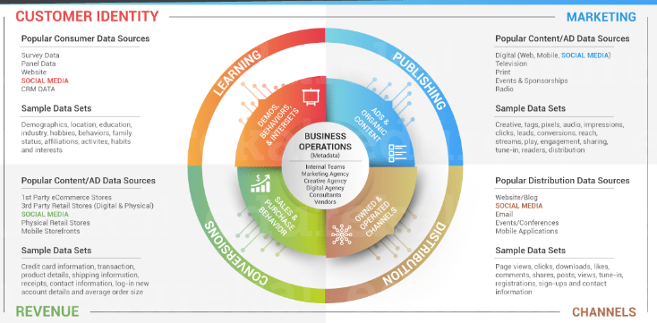
Media & Entertainment

Slide 25
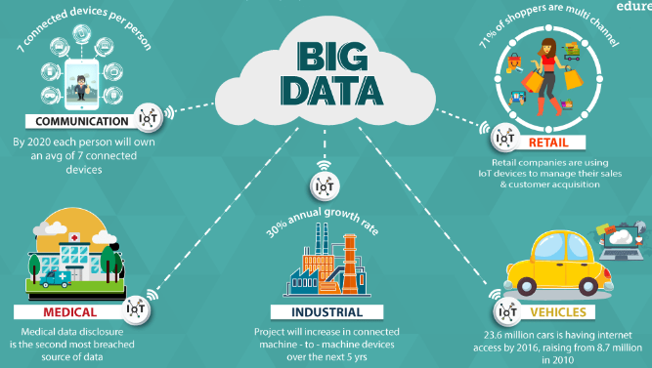
Internet of Things (IoT)

